Slide 1




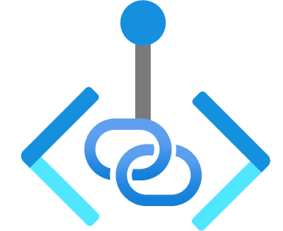




Virtual Network
Delegated Subnet
Default Subnet
GatewaySubnet
Injected Container
Private Endpoints
Dataverse Plug-in
Dataverse Plug-in
SQL Connector
On-premises
SQL Connector
Virtual Network Peering
Azure resources
Virtual Network Peering
Spoke Virtual Network
RISE with SAP

Slide 2

Korea Central 리전
hub-krc-vnet
spoke-krc-vnet
Delegated Subnet
default subnet
Injected Container
Private Endpoints
Virtual Network Peering
Dataverse Plug-in
Dataverse Plug-in
SQL Connector
SQL Connector
인터넷

